Slide 1
Embarrassingly Parallel Computations

Slide 2
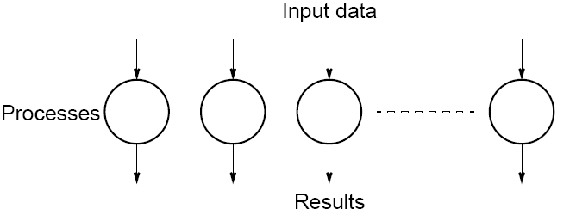
Embarrassingly Parallel Computations
A computation that can obviously be divided into a number of completely independent parts, each of which can be executed by a separate process(or).
No communication or very little communication between processes
Each process can do its tasks without any interaction with other processes
3.3

Slide 3
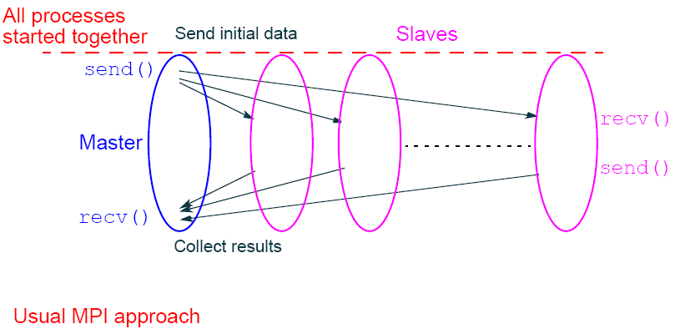
Practical embarrassingly parallel computation with static process creation and master-slave approach
3.4

Slide 4
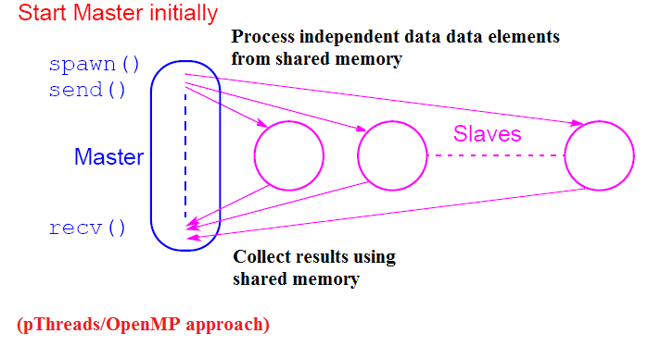
Practical embarrassingly parallel computation with dynamic process creation and master-slave approach
3.5

Slide 5
Embarrassingly Parallel Computation
Examples
• Low level image processing
• Mandelbrot set
• Monte Carlo Calculations
3.6

Slide 6
Low level image processing
Many low level image processing operations only involve local data with very limited if any communication between areas of interest.
3.7

Slide 7
Some geometrical operations
Shifting
Object shifted by Δx in the x-dimension and Δy in the y-dimension:
x′ = x + Δx
y′ = y + Δy
where x and y are the original and x′ and y′ are the new coordinates.
Scaling
Object scaled by a factor S_{x} in x-direction and S_{y} in y-direction:
x′ = xS_{x}
y′ = yS_{y}
3.8

Slide 8
Rotation
Object rotated through an angle q about the origin of the coordinate system:
x′ = x cosθ + y sinθ
y′ = -x sinθ + y cosθ
3.8

Slide 9
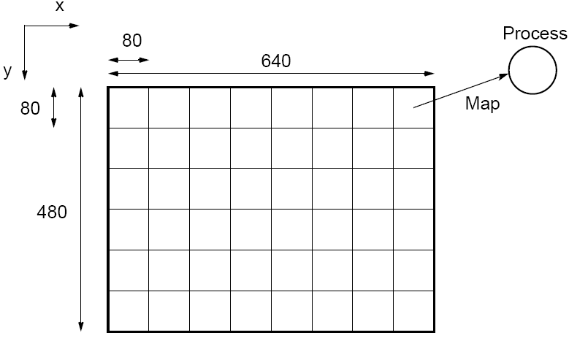
Partitioning into regions for individual processes
Square region for each process (can also use strips)
3.9

Slide 10


Mandelbrot Set
Set of points in a complex plane that are quasi-stable (will increase and decrease, but not exceed some limit) when computed by iterating the function
where z_{k +1} is the (k + 1)th iteration of the complex number z = a + bi and c is a complex number giving position of point in the complex plane. The initial value for z is zero.
Iterations continued until magnitude of z is greater than 2 or number of iterations reaches arbitrary limit. Magnitude of z is the length of the vector given by
3.10

Slide 11
Sequential routine computing value of
one point returning number of iterations
structure complex {
float real;
float imag;
};
int cal_pixel(complex c) {
int count, max;
complex z;
float temp, lengthsq;
max = 256;
z.real = 0; z.imag = 0;
count = 0; /* number of iterations */
do {
temp = z.real * z.real - z.imag * z.imag + c.real;
z.imag = 2 * z.real * z.imag + c.imag;
z.real = temp;
lengthsq = z.real * z.real + z.imag * z.imag;
count++;
} while ((lengthsq < 4.0) && (count < max));
return count;
}
3.11

Slide 12
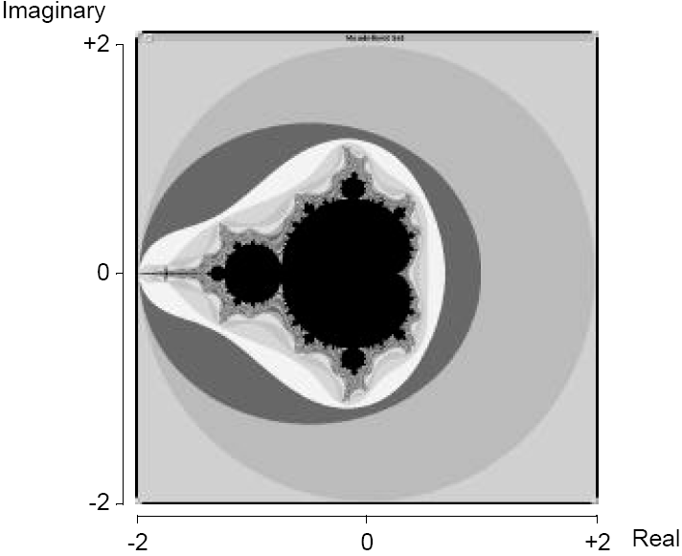
Mandelbrot set
3.12

Slide 13
Parallelizing Mandelbrot Set Computation
Static Task Assignment
Simply divide the region in to fixed number of parts, each computed by a separate processor.
Not very successful because different regions require different numbers of iterations and time.
Dynamic Task Assignment
Have processor request regions after computing previous
regions
3.13

Slide 14
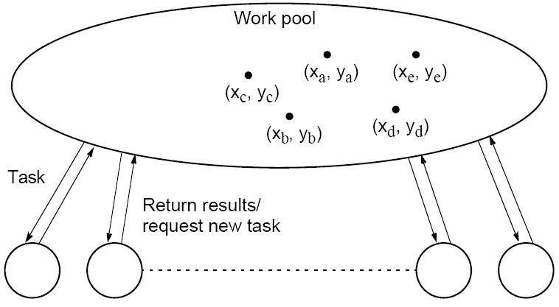
Dynamic Task Assignment
Work Pool/Processor Farms
3.14

Slide 15
Monte Carlo Methods
Another embarrassingly parallel computation.
Monte Carlo methods use of random selections.
3.15

Slide 16



Circle formed within a 2 x 2 square. Ratio of area of circle to square given by:
Points within square chosen randomly. Score kept of how many points happen to lie within circle.
Fraction of points within the circle will be , given a sufficient number of randomly selected samples.
3.16

Slide 17
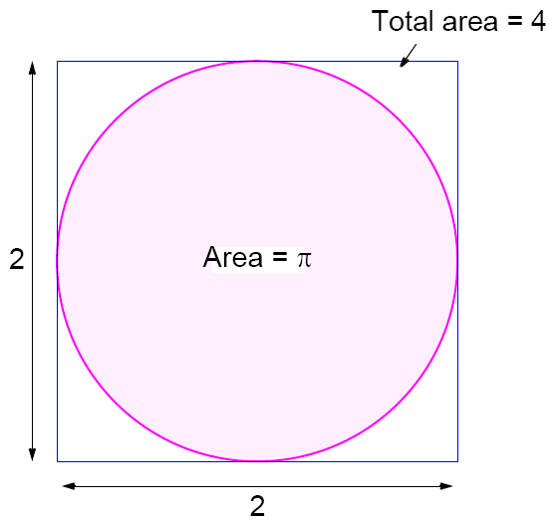
3.17

Slide 18

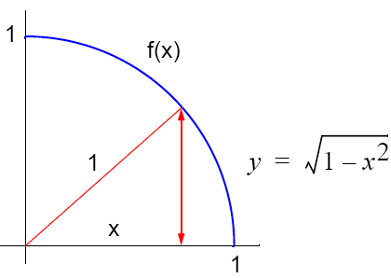

Computing an Integral
One quadrant can be described by integral
Random numbers, xr, are generated between x₁ and x₂
Counted as in circle if
3.18

Slide 19
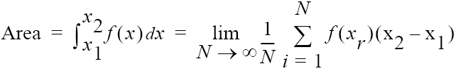
Alternative (better) Method
Use random values of x to compute f(x) and sum values of f(x):
where xr are randomly generated values of x between x₁ and x₂.
Monte Carlo method very useful if the function cannot be integrated numerically (maybe having a large number of variables)
3.19

Slide 20
Computing an Integral
One quadrant can be described by integral
Random pairs of numbers, (xr,yr) generated, each between 0 and 1.
3.18

Slide 21

Example
Computing the integral
Sequential Code
sum = 0;
for (i = 0; i < N; i++) { /* N random samples */
xr = rand_v(x1, x2); /* generate next random value */
sum = sum + xr * xr - 3 * xr; /* compute f(xr) */
}
area = (sum / N) * (x2 - x1);
Routine randv(x1, x2) returns a pseudorandom number between x1 and x2.
3.20

Slide 22
Outline
Random Numbers
Why To Prefer Pseudo- Random Numbers
Application Areas
The Linear Congruential Generators
Period of Linear Congruential Sequence
Approaches to the Generation of Random Numbers on Parallel Computers
Centralized
Replicated
Distributed

Slide 23
Random Numbers
Well-known sequential techniques exist for generating, in a deterministic fashion,
The number sequences are largely indistinguishable from true random sequences
The deterministic nature is important because it provides for reproducibility in computations.
Efficiency is needed by preserving randomness and reproducibility

Slide 24
Random Numbers
Consider the following experiment to verify the randomness of an infinite sequence of integers in labelled 1 to d.
Suppose we let you view as many numbers from the sequence as you wished to.
You should then guess any other number in the sequence.
If the likelihood of your guess being correct is greater than 1/d, then the sequence is not random.
In practice, to estimate the winning probabilities we must play this guessing game several times.

Slide 25
Why To Prefer Pseudo- Random Numbers
True random numbers are rarely used in computing because:
difficult to generate reliably
the lack of reproducibility would make the validation of programs that use them extremely difficult
Computers use pseudo-random numbers:
finite sequences generated by a deterministic process
but indistinguishable, by some set of statistical tests, from a random sequence.

Slide 26
Application Areas
Simulation: When we simulate natural phenomena, random numbers are required to make things realistic. For example: Operations research (where people come into airport at random intervals.)
Sampling: It is often impractical to examine all possible cases, but a random sample will provide insight into what constitutes "typical" behaviour.
Computer Programming: Random values make good source of data for testing the effectiveness of computer algorithms.

Slide 27
Application Areas
Numerical Analysis
Decision Making: There are reports that many executives make their decisions by flipping a coin or by throwing darts, etc.
Aesthetics: A little bit randomness makes computer-generated graphics and music seem more lively.
Recreation: "Monte Carlo method", a general term used to describe any algorithm that employs random numbers.

Slide 28
The Linear Congruential Generators
Generator is a function, when applied to a number, yields the next number in the sequence. For example,
X_{k+1} = (a X_{k} + c) mod m
where X_{k} is the k th element of the sequence and
X₀, a, c , and m define the generator.
Random numbers in the range [0,1] are then obtained by dividing by m.
As numbers are taken from a finite set (for example, integers between 1 and 2³¹), any generator will eventually repeat itself.

Slide 29
The Linear Congruential Generators
The length of the repeated cycle is called the period of the generator.
A good generator is one with a long period and no discernible correlation between elements of the sequence.
Example: X_{k+1} = (3X_{k} + 4) mod 8
E = {1, 7, 1, 7, …} is bad.

Slide 30
Period of Linear Congruential Sequence
Theorem: The linear congruential sequence has period m if and only if
c is relatively prime to m (i.e. if the only positive integer that evenly divides both of them is 1);
b = a - 1 is a multiple of p, for every prime p dividing m;
b is a multiple of 4, if m is a multiple of 4.
Example: X_{k+1} = (7X_{k} + 5) mod 18
E = {1, 12, 17, 16, 9, 14, 13, 6, 11, 10, 3, 8, 7, 0, 5, 4, 15, 2, 1,…}

Slide 31
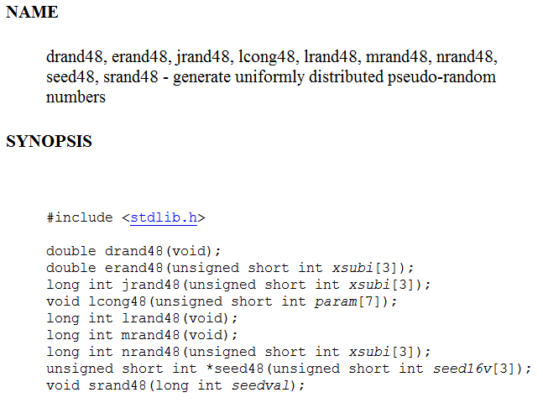
drand48() family of pseudo-random functions

Slide 32
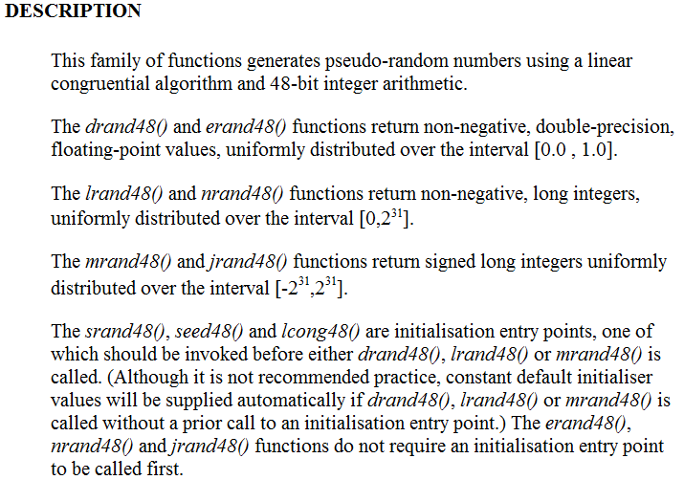
drand48() family of pseudo-random functions

Slide 33
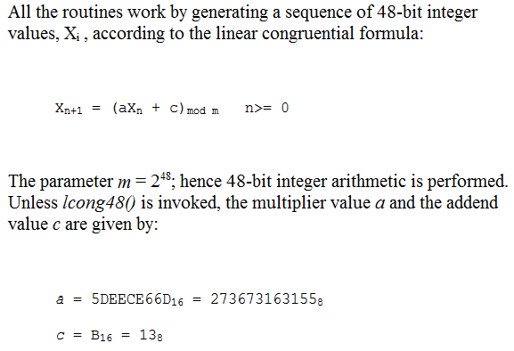
drand48() family of pseudo-random functions

Slide 34
Approaches to the Generation of Random Numbers on Parallel Computers
Centralized
Replicated
Distributed
From: Chapter 10 of on line text of Designing and Building Parallel Programs, by Ian Foster at
http://www.mcs.anl.gov/~itf/dbpp/text/book.html

Slide 35
Centralized Approach
A sequential generator is encapsulated in a task from which other tasks request random numbers.
Advantages:
Avoids the problem of generating multiple independent random sequences
Disadvantages:
Unlikely to provide good performance
Makes reproducibility hard to achieve: the response to a request depends on when it arrives at the generator, and the result computed by a program can vary from one run to the next.

Slide 36
Replicated Approach
Multiple instances of the same generator are created (for example, one per task). Each generator uses either the same seed or a unique seed, derived, for example, from a task or thread identifier.
Advantages:
Efficiency
Ease of implementation
Disadvantages:
Not guaranteed to be independent and, can suffer from serious correlation problems.

Slide 37
Distributed Approach
Responsibility for generating a single sequence is partitioned among many generators, which can then be parcelled out to different tasks.
Advantages:
The analysis of the statistical properties of the distributed generator is simplified because the generators are all derived from a single generator
Efficiency
Disadvantages:
Difficult to implement on parallel computers

Slide 38
Distributed Approaches
The techniques described here are based on an adaptation of the linear congruential algorithm called the random tree method.
This facility is particularly valuable in computations that create and destroy tasks dynamically during program execution.
The Random Tree Method
The Leapfrog Method
Modified Leapfrog

Slide 39
The Random Tree Method
The random tree method employs two linear congruential generators, L and R , that differ only in the values used for a.
L_{k+1} = (a_{L} L_{k} + c) mod m
R_{k+1} = (a_{R} R_{k} + c) mod m
L
R⁰
R¹
R²

Slide 40
Application of the left generator L to a seed generates one random sequence; application of the right generator R to the same seed generates a different sequence.
By applying the right generator to elements of the left generator's sequence (or vice versa), a tree of random numbers can be generated.
for new right sequences.
L
R⁰
R¹
R²

Slide 41
By convention, the right generator R is used to generate random values for use in computation, while the left generator L is applied to values computed by R to obtain the starting points R⁰, R¹ , etc., for new right sequences.
L
R⁰
R¹
R²

Slide 42
Random Tree Method
Advantages:
Useful to generate new random sequences in a reproducible and noncentralized fashion. This is valuable, in applications in which new tasks and hence new random generators must be created dynamically.
Disadvantages:
There is no guarantee that different right sequences will not overlap. If two starting points happen to be close to each other, the two right sequences that are generated will be highly correlated.

Slide 43
The Leapfrog Method
A variant of the random tree method
Used to generate sequences that can be guaranteed not to overlap for a certain period.
Useful where a program requires a fixed number of generators.
For example, one generator for each task where we know the number of tasks at run time.

Slide 44
R⁰
R¹
L_0
R²
L_1
L_2
L_3
L_4
L_5
L_6
L_7
L_8
The leapfrog method with n=3. Each of the right generators selects a disjoint subsequence of the sequence constructed by the left generator’s sequence.

Slide 45
The Leapfrog Method
Let n be the number of sequences required. Then we define a_{L} and a_{R} as a and a^{n}, respectively,
L_{k+1} = (a L_{k} + c) mod m
R_{k+1} = (a^{n} R_{k} + c) mod m
Create n different right generators R₀ ... R_{n-1} by taking the first n elements of L as their starting values.

Slide 46
The Leapfrog Method
The name “leapfrog method” refers that the ith sequence R^{i} consists of L_{i} and every nth subsequent element of the sequence generated by L.
As the method partitions the elements of L, each subsequence has a period of at least P/n, where P is the period of L.
The n subsequences are disjoint for their first P/n elements.

Slide 47
The Leapfrog Method
The generator for the r th subsequence, R^{r} , is defined by a^{n} and R^{r}₀ = L_{r}.
First, compute a^{r} and a^{n}
Then, compute members of the sequence R^{r} as follows, to obtain n generators, each defined by a triple (R^{r}₀, a^{n}, m) , for
0 <= r < n .
R^{r}₀ = (a^{r} L₀) mod m
R^{r}_{i+1} = (a^{n} R^{r}_{i}) mod m

Slide 48
Modified Leapfrog
A variant of the leapfrog method
Used in situations, where we know the maximum number, n , of random values needed in a subsequence but not the number of subsequences required.
The role of L and R are reversed so that the elements of subsequence i are the contiguous elements
L_{k+1} = a^{n} L_{k} mod m
R_{k+1} = a R_{k} mod m
It is not a good idea to choose n as a power of two, as this can lead to serious long-term correlations.

Slide 49
R0
R1
R2
…
L_0
L_1
L_2
L_3
L_4
L_5
L_6
L_7
L_8
Figure: Modified leapfrog with n=3 . Each subsequence contains three contiguous numbers from the main sequence.

Slide 50
Some Tests For Random Number Generators
The basic idea behind the statistical tests is that the rabdom number streams obtained from a generator should have the properties of a random sample drawn from the uniform distribution.
Tests are designed so that the expected value of some test statistic is known for uniform distribution.
The empirically generated random number stream is then subject to the same test, and the statistic obtained is compared against the expected value.

Slide 51
Frequency Test
The focus of the test is the proportion of zeroes and ones for the entire sequence.
Example:
(input) E=1100100100001111110110101010001000100001011010001100001000110100110001001100011001100010100010111000
(input) n = 100
(output) P-value = 0.109599
(conclusion) Since P-value >= 0.01, accept the sequence as random.

Slide 52
Runs Test
A run is an uninterrupted sequence of identical bits.
The focus of this test is the total number of runs in the sequence.
A run of length k consists of exactly k identical bits and is bounded before and after with a bit of the opposite value.
The purpose of the runs test is to determine whether the number of runs of ones and zeros of various lengths is as expected for a random sequence.
Determines whether the oscillation between such zeros and ones is too fast or too slow.

Slide 53
Runs Test
A fast oscillation occurs when there are a lot of changes, e.g., 010101010 oscillates with every bit.
(input) E = 1100100100001111110110101010001000100001011010001100001000110100110001001100011001100010100010111000
(input) n = 100
(output) P-value = 0.500798
(conclusion) Since P-value >= 0.01, accept the sequence as random.

Slide 54
Testing Parallel Random Number Generators
A good parallel random number generator must be a good sequential generator.
Sequential tests check for correlations within a stream, while parallel tests check for correlations between different streams.

Slide 55
Testing Parallel Random Number Generators
Exponential sums
Parallel spectral test
Interleaved tests
Fourier transform test
Blocking test

Slide 56
Fourier Transform Test
Fill a two dimensional array with random numbers. Each row of the array is filled with random numbers from a different stream.
Calculate the Fourier coefficients and compare with the expected values.
This test is repeated several times and check if there are particular coefficients that are repeatedly “bad”.

Slide 57
Blocking Test
Use the fact that the sum of independent variables asymptotically approaches the normal distribution to test for the independence of random number streams.
Add random numbers from several stream and form a sum.
Generate several such sums and check if their distribution is normal.

Slide 58
SPRNG
SPRNG (Scalable Parallel Pseudo Random Number Generators Library) http://sprng.cs.fsu.edu/
A “Scalable Library for Pseudorandom Number Generation”,
Designed to use parametrized pseudorandom number generators to provide random number streams to parallel processes.
Includes
Several, qualitatively distinct, well tested, scalable RNGs
Initialization without interprocessor communication
Reproducibility by using the parameters to index the streams

Slide 59
Reproducibility controlled by a single “global” seed
Minimization of interprocessor correlation with the included generators
A uniform C, C++, Fortran and MPI interface
Extensibility
An integrated test suite.

Slide 60
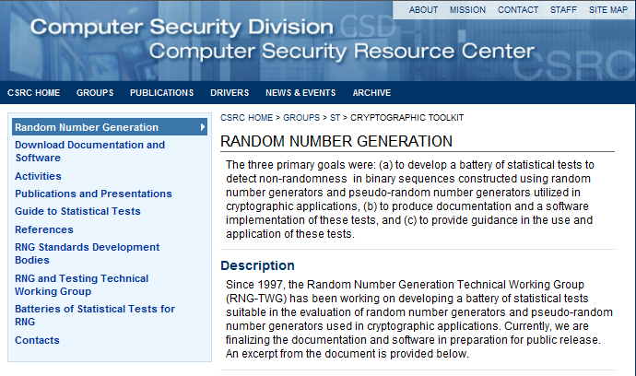
NIST Random Number Tests

Slide 61
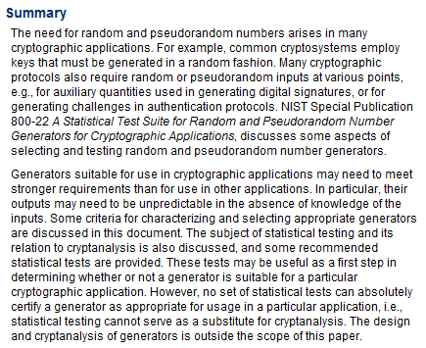
NIST Random Number Tests

Slide 62
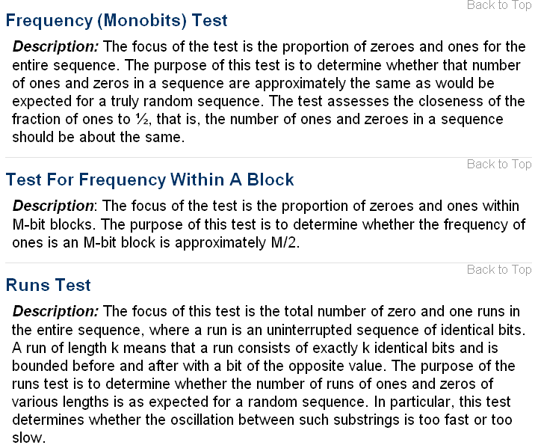
NIST Random Number Tests

Slide 63
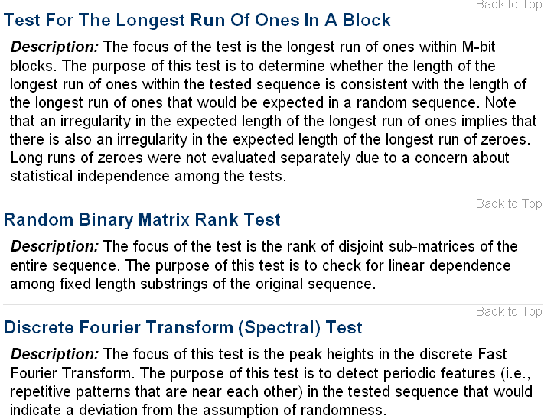
NIST Random Number Tests

Slide 64
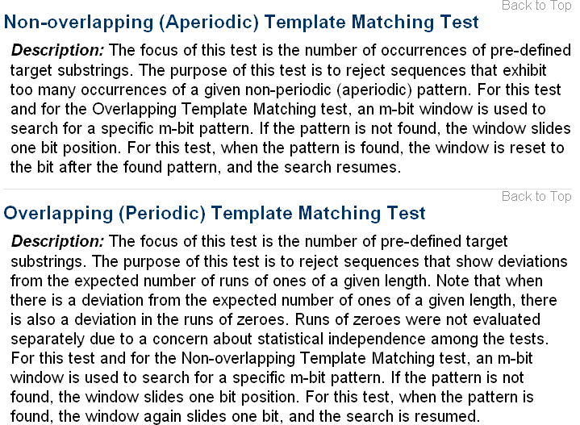
NIST Random Number Tests

Slide 65
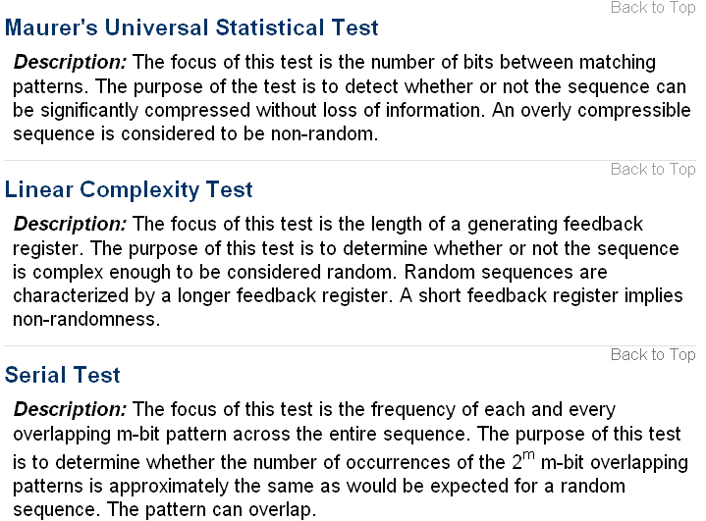
NIST Random Number Tests

Slide 66
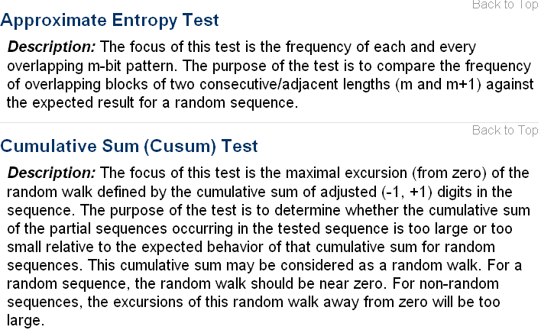
NIST Random Number Tests

Slide 67
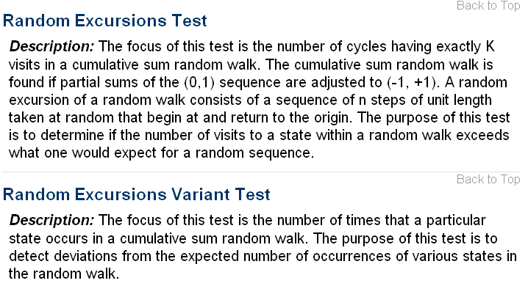
NIST Random Number Tests

